Slide 1
CUSTOMER CHURN RATE ANALYSIS
Insights for Reducing Churn, Improving Service, and Enhancing Satisfaction

Slide 2
Introduction
The following SQL case study aims to analyzing the possibility of bank customer churn based on insights gathered from the datasets.
Insights from personal info such as age, gender, income and demographic location, credit card and non-credit card holders, products, their credit score and how long the customer has been with the bank. It is advantageous for the bank to know how to retain customer loyalty, rather than looking out for another customer.
Bank has given us the datasets of Bank’s customer data, Bank_churn and customer information which includes customer’s demographics such as Name, Age their address, Salary etc.
For this project, we will concentrate on Voluntary Churn, because it can be occurs due to factors of the company-customer relationship which companies control, such as how billing interactions are handled or how after-sales help is provided.

Slide 3
Objective Questions Overview
To understand the churn rate of customers in each aspects of the demographics, Bank has provided us the set of objectives. To analyse each objective, I have used SQL query to generate the insights from the given data.
These objective includes:
Distribution of account balance across different regions?
Calculate the average number of products used by customers who have a credit card.
Determine the churn rate by gender for the most recent year in the dataset.
Compare the average credit score of customers who have exited and those who remain.
Segment the customers based on their credit score and identify the segment with the highest exit rate.
Find out which geographic region has the highest number of active customers with a tenure greater than 5 years
Trend of customer joining over time and identify any seasonal patterns?
With the help of these objectives, we were able to analyse the customer churn rate with respect to each demographics (Age, country, Tenure). We observed customers relationship between churned and non-churned customers, their credit score as well as their activity status.

Slide 4
Subjective Questions Overview
The aim of subjective questions provided by the Bank is to visualize the data based on our analysis of the problem statement. I have used Power BI and SQL to extract the information from the dataset.
Customer Behaviour Analysis: analyzed spending habits of long-term customers compared to new customers by creating a calculated column in Power BI with the help of Credit card status we gained knowledge of spending habits of Customers.
Product Affinity Study: Observed most common services used by customers. Bank’s target should include other services with the products being purchased by the customers in offers. Suppose in a market campaign where we incorporate other services with the products which are purchased by customer that have long tenures.
Geographic Market Trends: Here, we suggested the Bank’s market was hugely observed in Germany. Half of the customers churned were belongs to Germany. We can analyse further to see the market capitalization of Banks where customers churned rate is equally competitive with our Bank. To crunch the numbers we would need additional data which Bank has not retrieved it yet.
Customer Exit Reasons Exploration: Identified trends among customers who have exited the bank, with the help of various demographics. I explored the churn rate and the found the yearwise and countrywise customers churned rate. Females accounted the highest number and age group of 50+ peoples were observed churning from the bank.

Slide 5
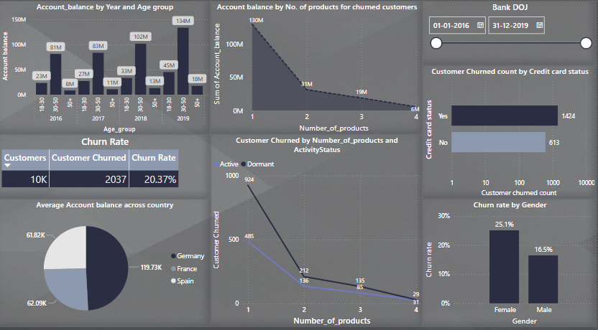
Data Exploration
Data Profiling: Checked the data types of all the columns where Bank_date_of_joining was incorrectly assigned text data type. I used update query to change the data type to Date.
Data Cleaning: For accurate analysis, checked the null values in all the tables.
Data Visualization: For understanding patterns, trends, and outliers in our dataset. A good dashboard can answer questions and bring insights to the table immediately, rather than forcing users to plow through data and figure out what is important to them.
Here’s a glimpse of a dashboard created for this project.

Slide 6
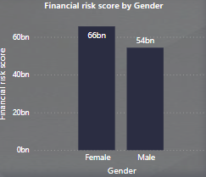
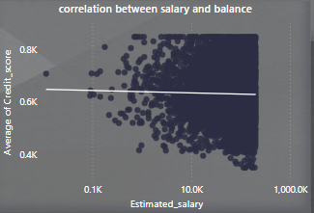
Churn Analysis
Overall Churn Rate: The overall churn rate is 20%, which indicates that around one in six customers were churning. This is a key metric for the bank to continuously monitor in its effort to mitigate churn and increase customer retention.
Customer Demographics: Overall, the average customer age is 46 yrs, and there are more female customers than male customers, with the majority of customers in the 41-50 age range. The churn summary indicates that female clients also aged between 41-50 have the highest churn rate
Correlation between Salary and credit card scores: Based on our scatter plot between average credit score and estimated salary the correlation is slightly decreasing the average credit score tends to decrease slightly, or vice versa. However, it's important to note that the correlation is weak, meaning the relationship is not very strong or pronounced.

Slide 7

Conclusion
The analysis highlights the need for the bank to focus on retaining its established and long-term customers in all income categories. especially female card holders based in Germany.
Targeted marketing ad campaigns should be used to effectively reach the customer segments contributing the most to churn. Examples of such campaigns include:
Providing financial education and resources to both male and female graduates, such as webinars, podcasts, or blog posts, to help them manage their finances more effectively.
Partnering with brands that appeal to the target audience (e.g partnering with fitness brands and offering discounts on gym memberships or workout gears to male and female graduates who are married or single)
Providing personalized investment advice and retirement planning services to established and long-term customers, which could help them maximize their savings and achieve their long-term financial goals.

Slide 8


